Slide 1
TIME MANAGEMENT SKILLS
MAP-ID BENGALURU
TRAINING
On
Time Management Skills
MUSASHI AUTO PARTS INDIA PVT. LTD.
BENGALURU PLANT

Slide 2
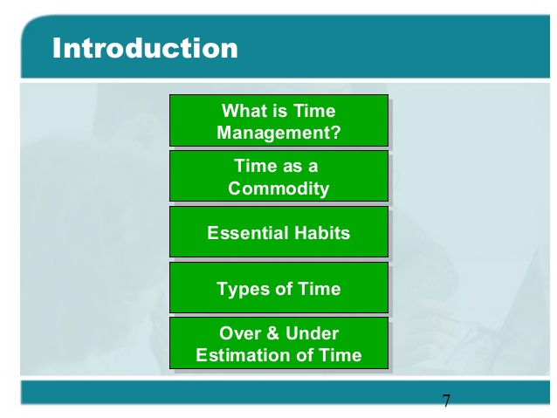
TIME MANAGEMENT SKILLS
Training Topics
How to use Time Effectively?
Analysis of Goals & Objectives
Planning
Summary of Training

Slide 3
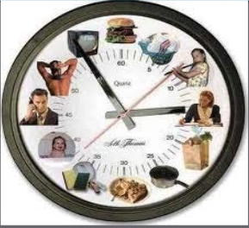
TIME MANAGEMENT SKILLS

Slide 4
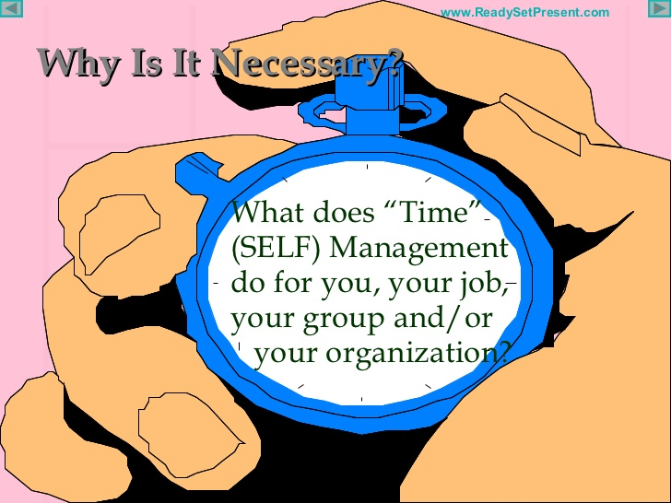
TIME MANAGEMENT SKILLS

Slide 5
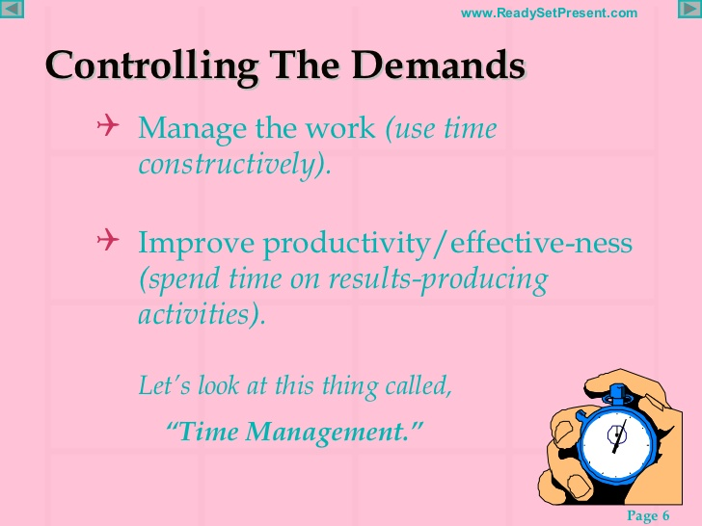
TIME MANAGEMENT SKILLS

Slide 6
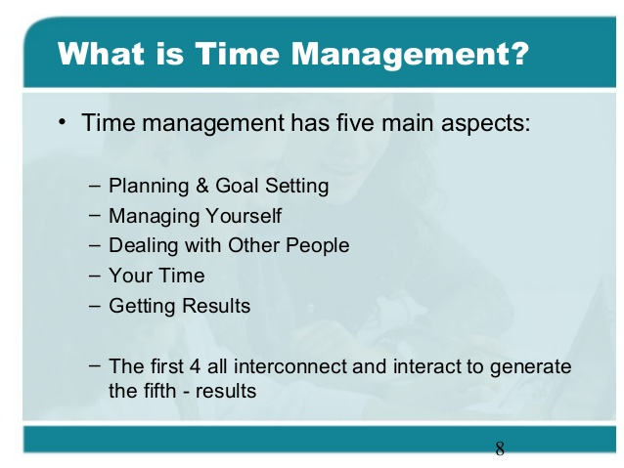
TIME MANAGEMENT SKILLS

Slide 7
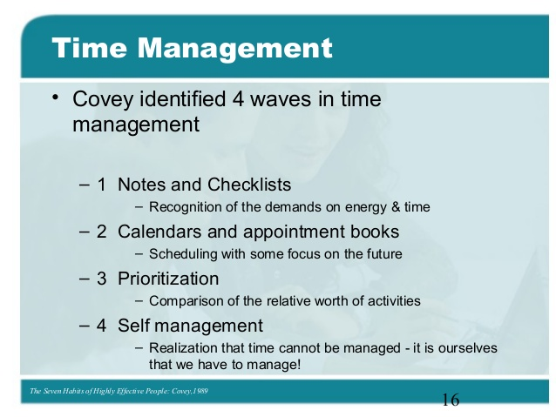
TIME MANAGEMENT SKILLS

Slide 8
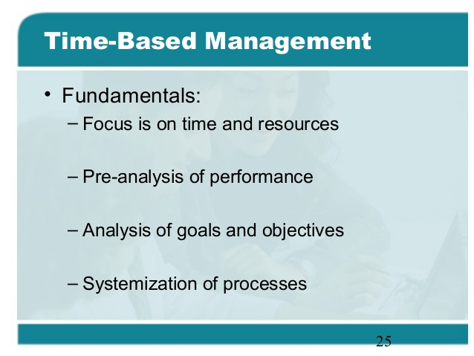
TIME MANAGEMENT SKILLS

Slide 9
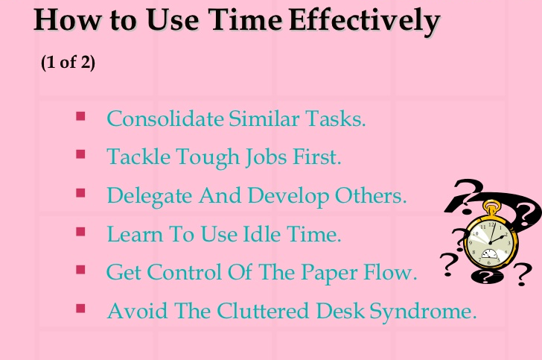
TIME MANAGEMENT SKILLS

Slide 10
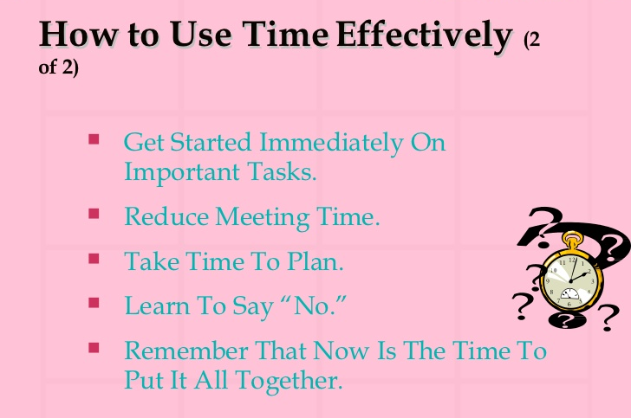
TIME MANAGEMENT SKILLS

Slide 11
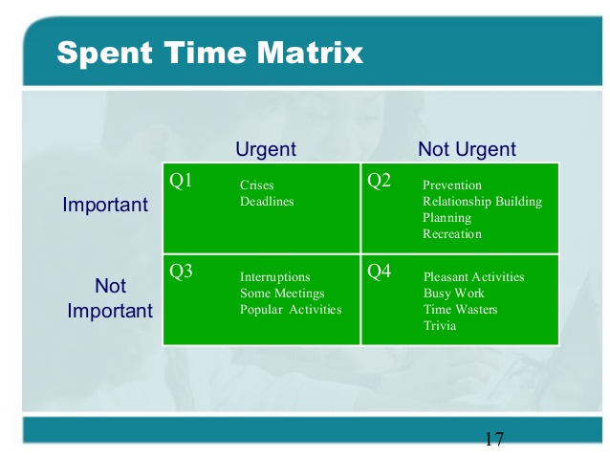
TIME MANAGEMENT SKILLS

Slide 12
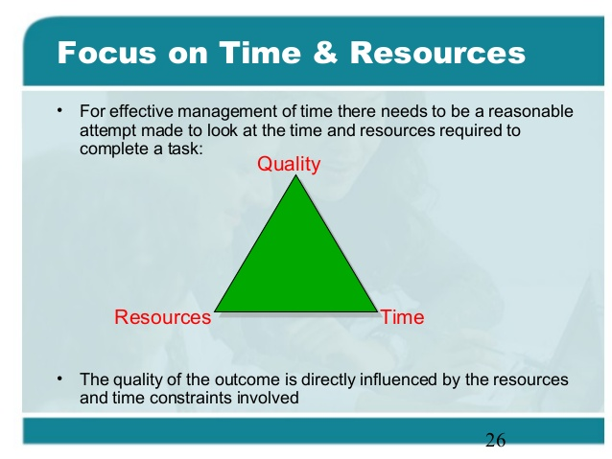
TIME MANAGEMENT SKILLS

Slide 13
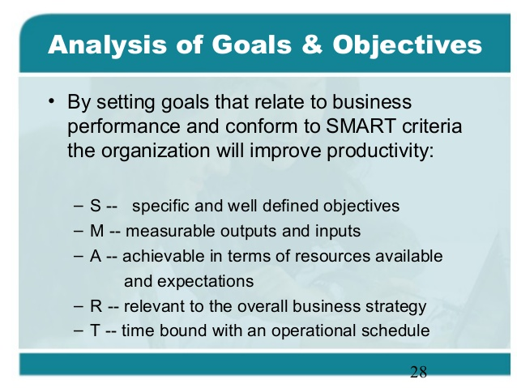
TIME MANAGEMENT SKILLS

Slide 14
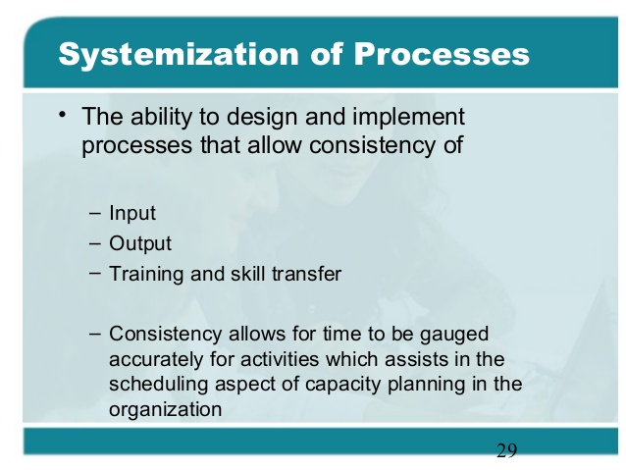
TIME MANAGEMENT SKILLS

Slide 15
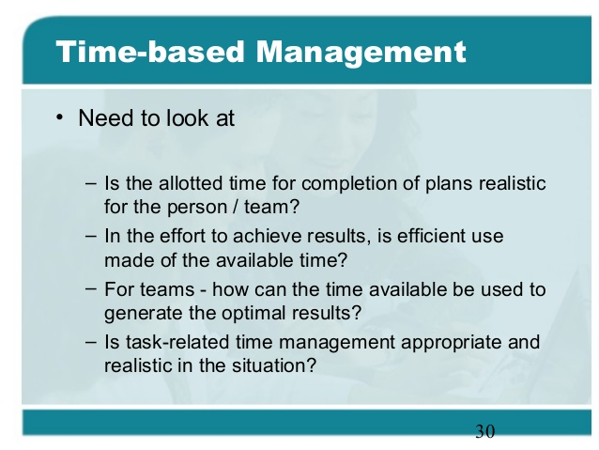
TIME MANAGEMENT SKILLS

Slide 16
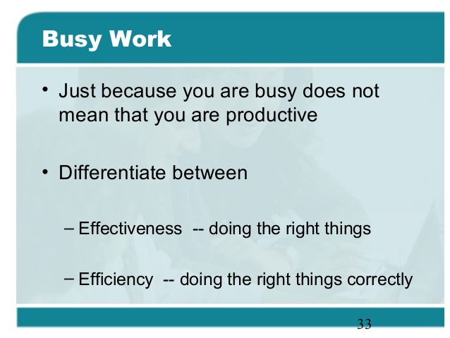
TIME MANAGEMENT SKILLS

Slide 17
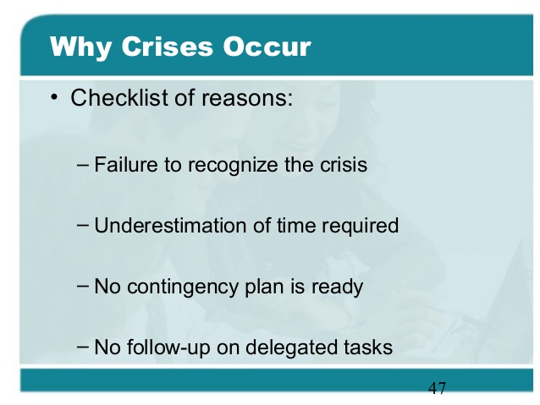
TIME MANAGEMENT SKILLS

Slide 18
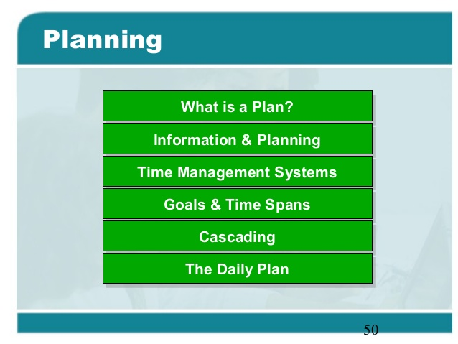
TIME MANAGEMENT SKILLS

Slide 19
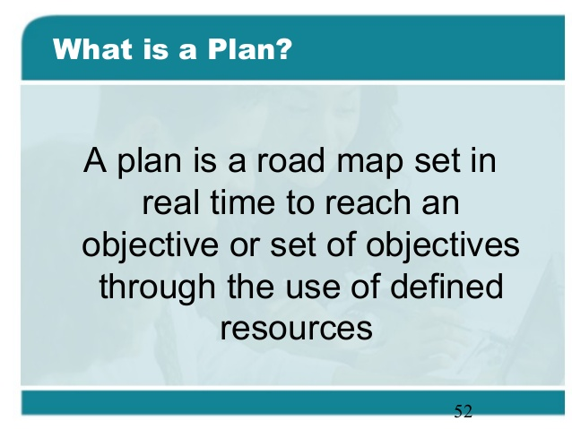
TIME MANAGEMENT SKILLS

Slide 20
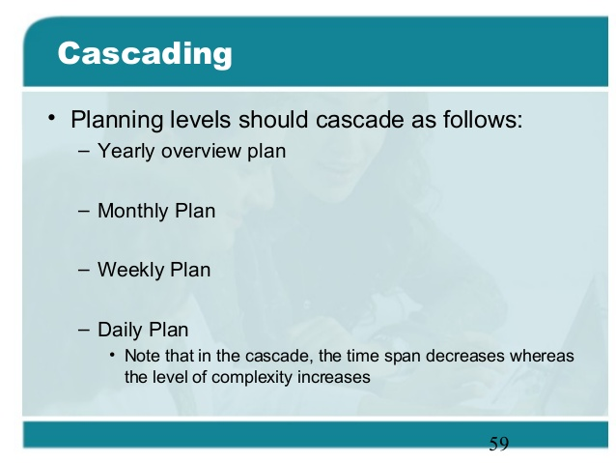
TIME MANAGEMENT SKILLS

Slide 21
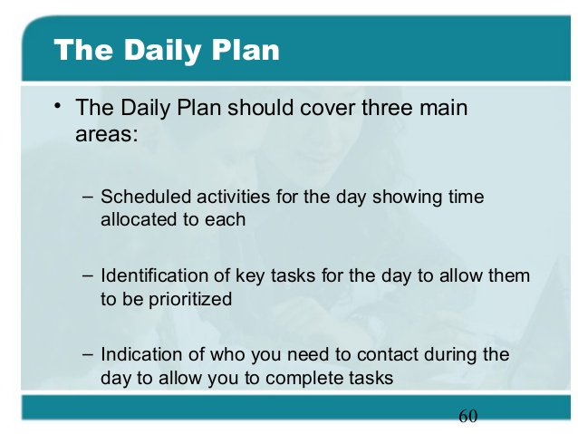
TIME MANAGEMENT SKILLS

Slide 22
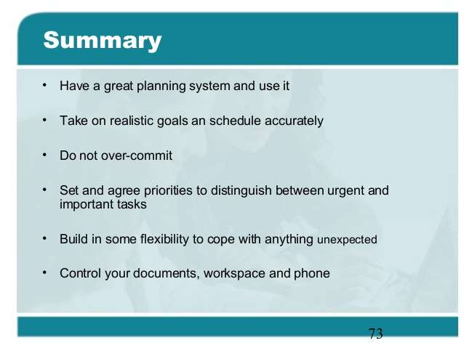
TIME MANAGEMENT SKILLS

Slide 23
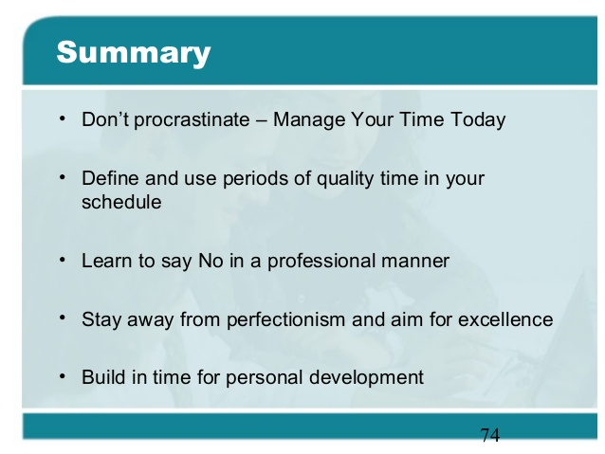
TIME MANAGEMENT SKILLS

Slide 24

TIME MANAGEMENT SKILLS
QUESTION TIME

Slide 25
TIME MANAGEMENT SKILLS
THANK YOU
Keep Learning to improve your Skill level

